Slide 1
IPL MATCH WINNER PREDICTION
MAUL SRI M
DA/DS ONLINE B5
20-03-2025

Slide 2
INTRODUCTION
Predicting the winner by analyzing features.
Build a machine learning model.
Identify the best-performing model through evaluation.
Enhance model performance for more accurate predictions.

Slide 3
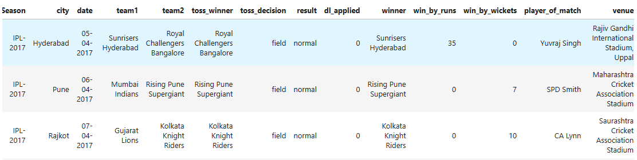
DATA UNDERSTANDING
Dataset contains detailed information about past IPL matches.
Key columns also capture player performances.
Features like teams, toss outcomes, match results, and venue.

Slide 4
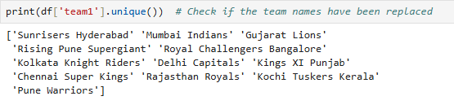
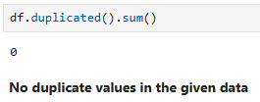
DATA CLEANING
Dataset contain 752 rows and 13 columns.
Ensure unique categorical values.
“Umpire3” contains the maximum missing values.
Missing values in “winner” were dropped.

Slide 5
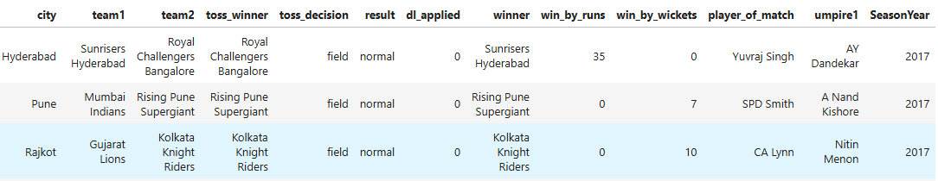
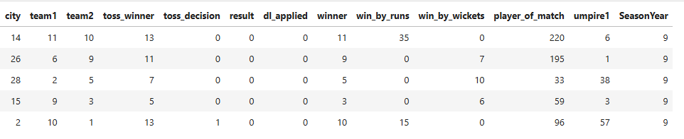
DATA PREPROCESSING
BEFORE
AFTER

Slide 6
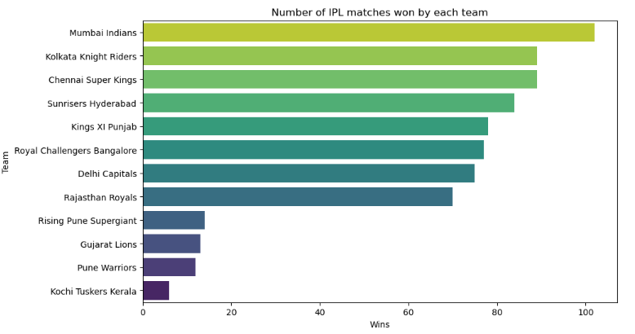
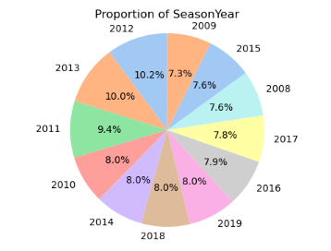
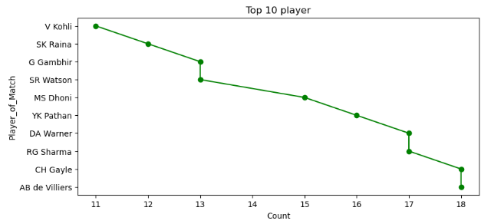
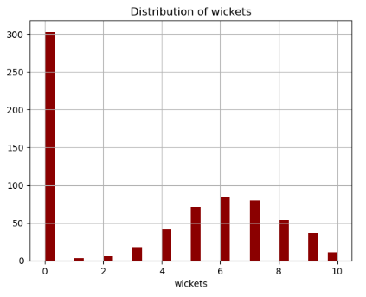
EDA ANALYSIS

Slide 7
EDA INSIGHTS
Mumbai Indians won the maximum matches.
Toss wining teams prefer fielding over batting.
Major matches have a lower number of wickets taken.
Number of matches peaking around 2012 and 2013.
Virat Kohli leads the player of match overall.

Slide 8
MODELING PROCESS
Split data (80% training, 20% testing)
Applied StandardScaler for feature scaling.
Started with Logistic Regression, KNN, SVM, Decision Trees.
Assessed performance using Accuracy, Precision, Recall, F1-Score, ROC AUC, and Confusion Matrix.
Selected the best model based on performance and feature analysis.

Slide 9
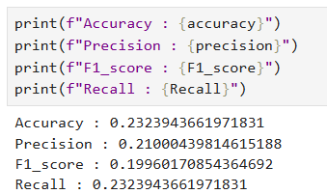
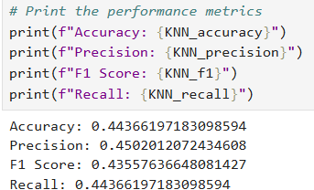
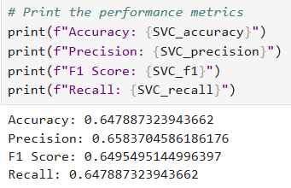
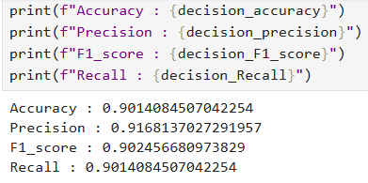
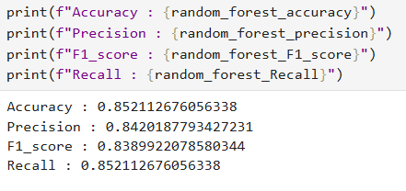
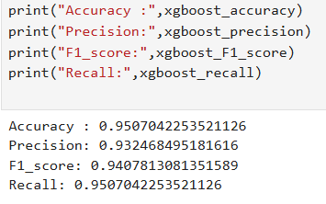
MODELING OUTCOMES
LOGISTIC REGRESSION
KNN
SVC
DECISION TREE
RANDOM FOREST
XGBOOST

Slide 10
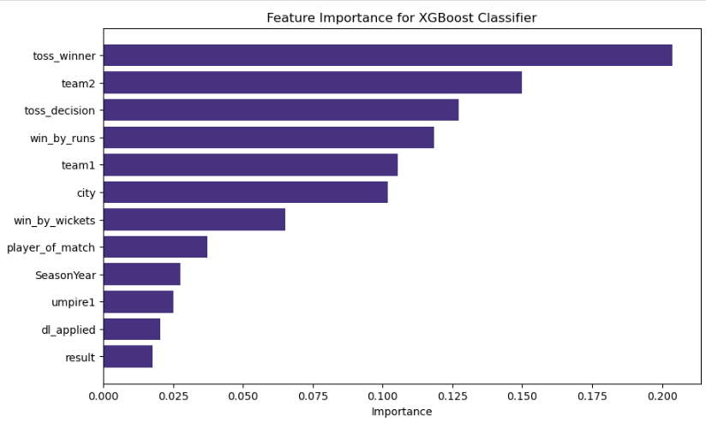
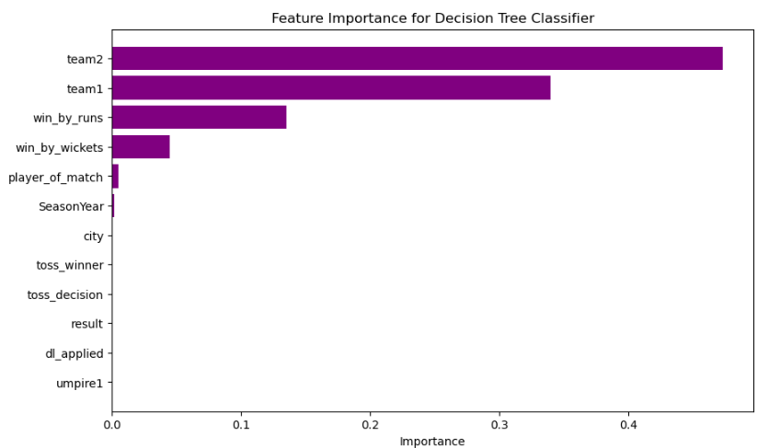
MODEL COMPARISON
XGBoost outperforms than other model
Decision Tree performs better than Random forest.
Logistic Regression are weak models with poor accuracy.

Slide 11
FUTURE STEPS
Implement K-Fold cross-validation to assess how well your models generalize across different data splits.
Perform a deeper error analysis by reviewing the types of errors each model is making
Implement strategies such as SMOTE, class weights, or ensemble methods to address the issue of class imbalance.

Slide 12
CONCLUSION
Combination of feature engineering and tuning.
Offering interpretability through feature importance.
Providing reliable predictions and decision support.
Clear need for model tuning, handling class imbalance.

Slide 13
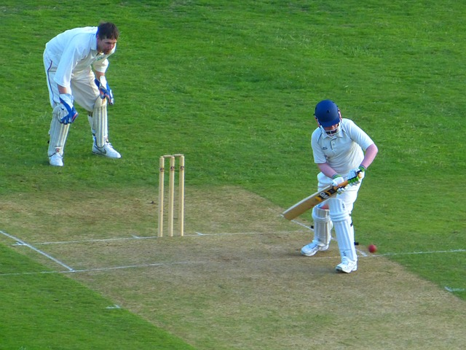
THANK YOU

